Slide 1
Intro to Unity
Components 1
Justin Park

Slide 2
What are components?
Components make GameObjects do things
These include
Colliders, which let objects collide
Rigidbody, which applies physics
Animators, which animate the object
Meshes, which let you see the object
Scripts, which YOU get to write to make objects do specific behaviors

Slide 3
Rigid Body Component
Let’s make our GameObject move
- add a rigid body component

Slide 4
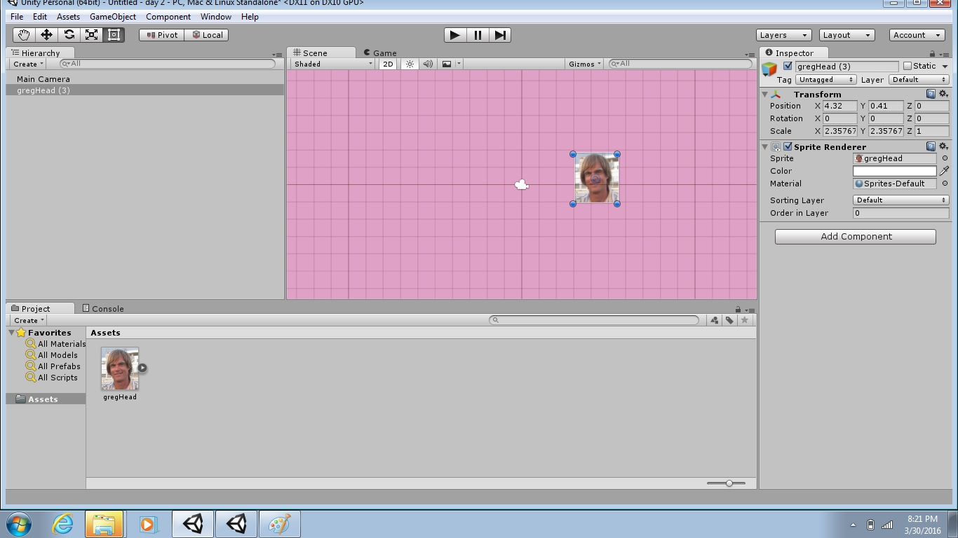
Select “Add Component”

Slide 5
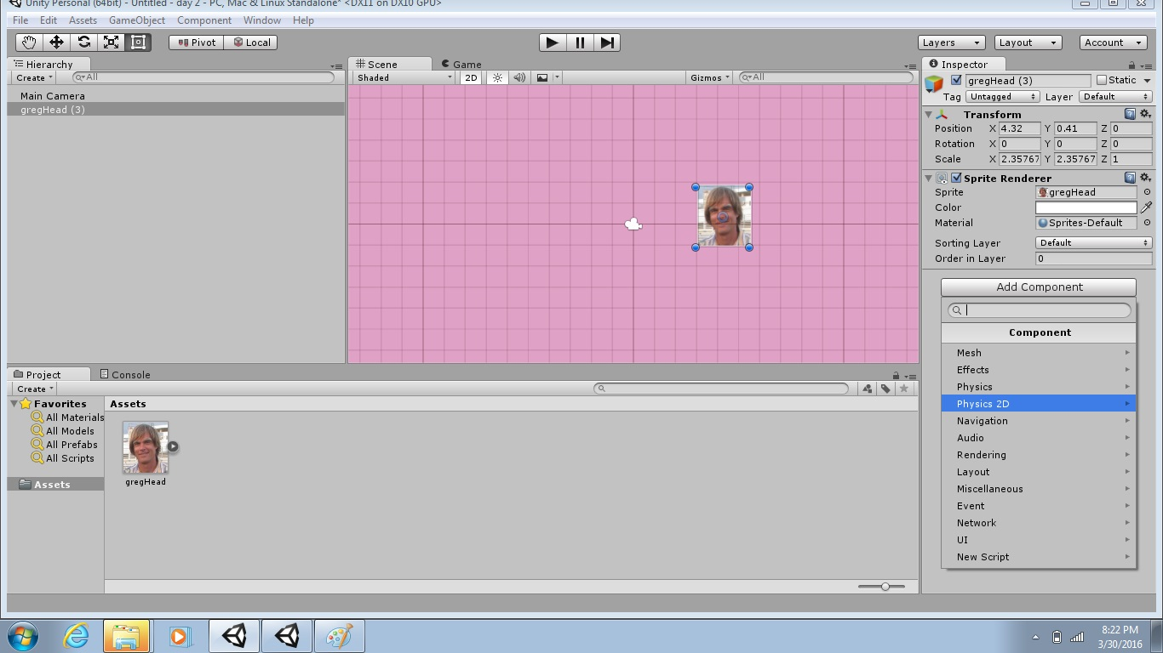
Select “Physics 2D”

Slide 6
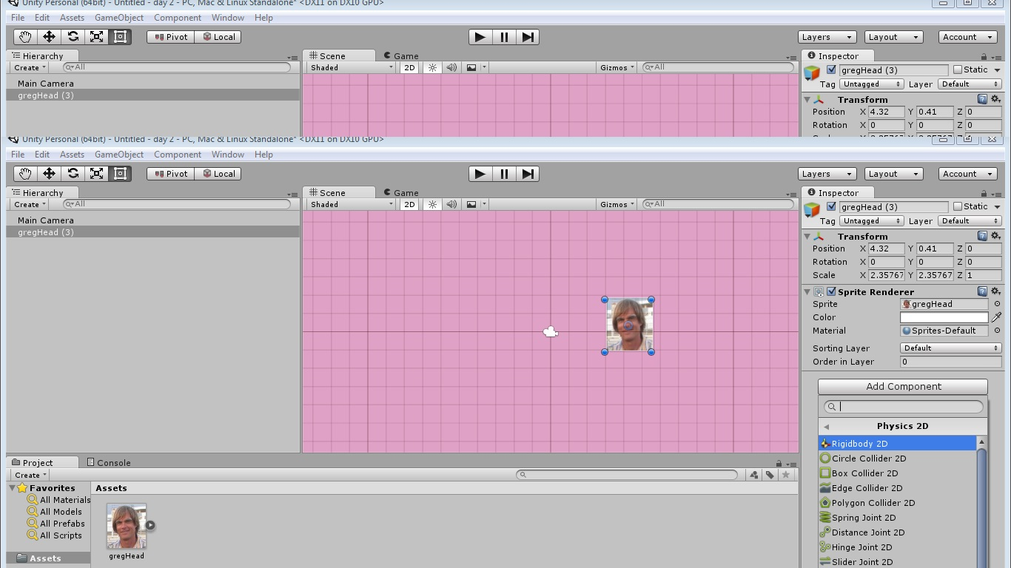
Select “RigidBody 2D”

Slide 7
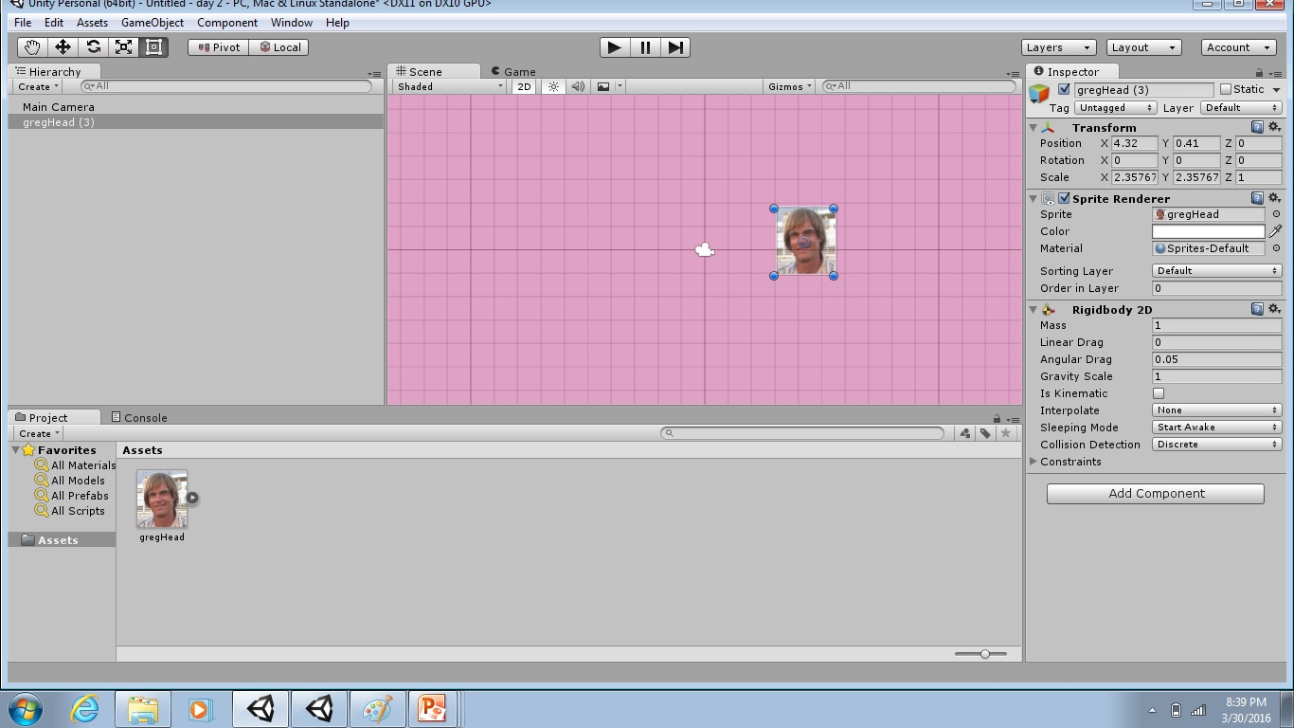
Adjust Gravity Affect

Slide 8
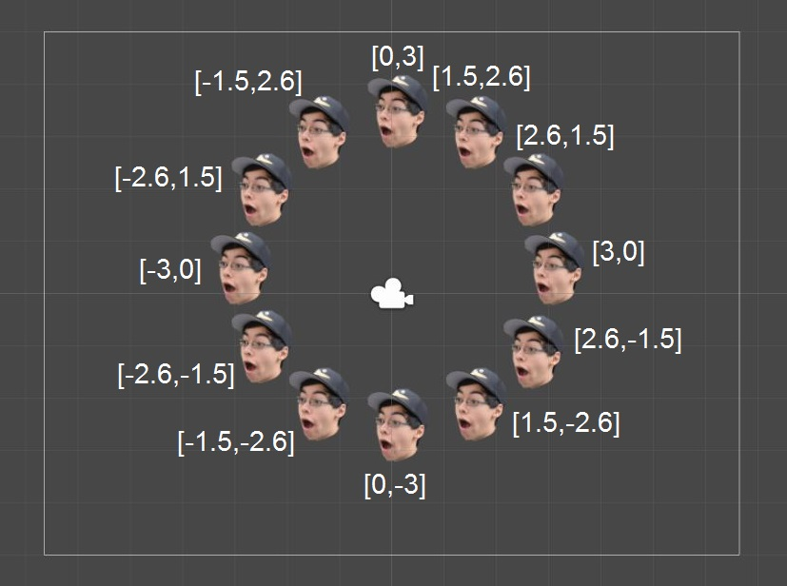
Lab
Upgrade the previous “clock” lab so that each of the 12 GameObjects falls at a different speed.

